Slide 1
Staying Sane During Baby Season And Other Myths

Slide 2
Participants will be able to:
Acknowledge that they are only human.
Learn a few quickie crisis management strategies
Recognize need for self-care when working long term in animal rescue/wildlife rehab
Identify specific strategies for self-care
Identify need to maintain boundaries
Entertain the idea of saying “No”

Slide 4
The Myth

Slide 5
THE REALITY

Slide 6
Truth: It Can Be Intense And Difficult.

Slide 7
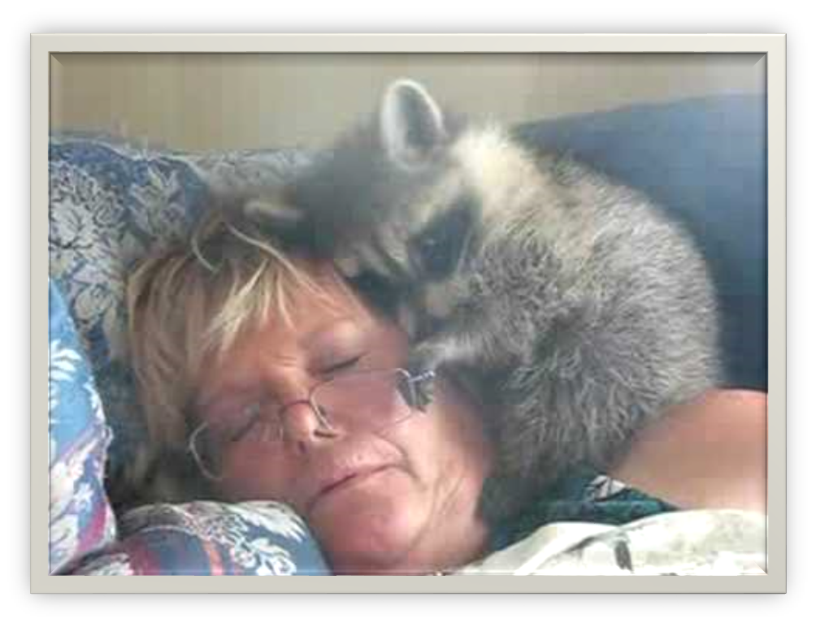
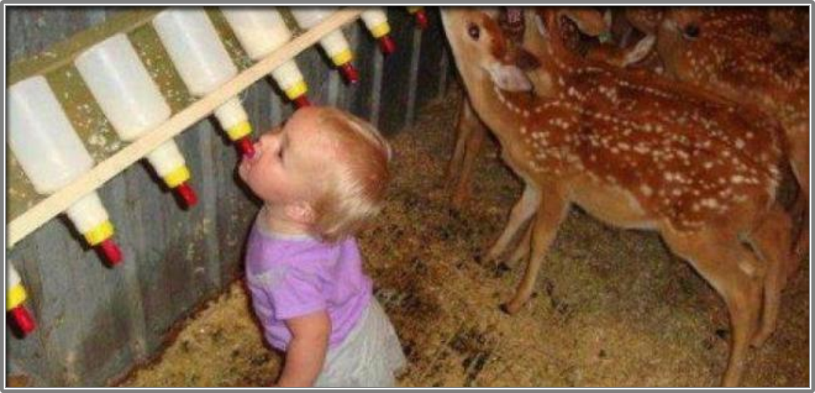
It can affect every part of your life

Slide 9
CRISIS STRESS MANAGEMENT

Slide 10
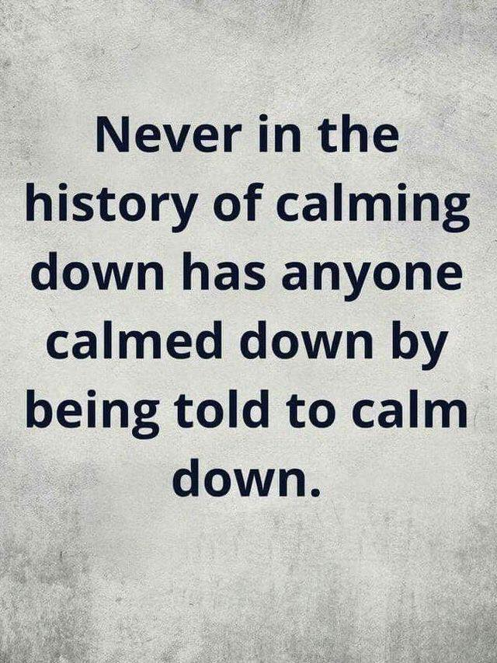

Slide 11
Stacia’s Super Secret Proprietary Technique for Calming Down when You Can’t Breathe Right

Slide 12
Ta–da! Naming Things
No. Really. Just naming things from different categories
Everything blue, or round, or in pairs…

Slide 13
FIVE SENSES -Present Moment
Five things you can see
Four things you can feel
Three things you can hear
Two things you can smell
One thing you can taste

Slide 14
Just solve the problem in front of you

Slide 15
Quick Practice – Small Group
Think of a thing about rescue that creates a sense of anxiety
With your group try at least one technique
Discuss the results

Slide 16
Think of your “Happy Place”
Mine
Not mine

Slide 17
Distress Tolerance – Sometimes life is a B****, but you don’t have to be one too.

Slide 18
Radical Acceptance

Slide 19
Self-Soothe – using your five senses and memories

Slide 20
A.C.C.E.P.T.S
Activities
Contributions
Comparisons
Emotions
Push Away Negativity
Think about something else
Sensations

Slide 22
THE LONG TERM RISKS OF CARING
Burnout
Vicarious Trauma
Compassion Fatigue

Slide 23
BURNOUT – Dread the work, feel unsatisfied, don’t feel like talking to people about it. Going through the motions. Lost the joy of it.

Slide 24
Vicarious Trauma
Because we don’t wear emotional haz-mat suits

Slide 25
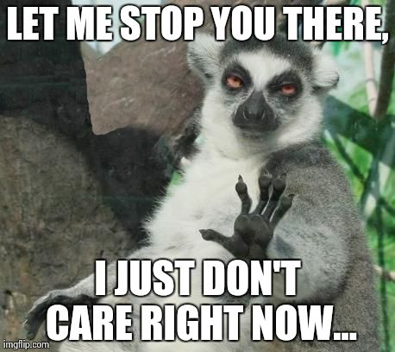
Compassion Fatigue

Slide 26
Compassion Fatigue
The ability to feel and care for others becomes eroded through exhaustion of the ability to be compassionate.

Slide 27
“It is not that we have too little time to do all the things we need to do, it is that we feel the need to do too many things in the time we have.”
— Gary W.

Slide 28
Fact or Fiction ?
You should be able to handle everything all the time without needing anyone or anything

Slide 30
As heroic as you all are…
Just because we can do anything, it doesn’t mean we can do everything!

Slide 31
Rescuing can feel good. Beware of the Risk of Hoarding
Be Realistic
Avoid Isolation
Trust Other People
Know when to say when
Seek mental health care when needed

Slide 32
Self-destructive coping
Using drugs, alcohol or unhealthy food to cope

Slide 33
Self-Care: it is a thing!
Self-care is attending to your health and well-being
It is NOT selfish, it is essential

Slide 34
You cannot pour from an empty cup

Slide 35
The part where people might imagine they don’t have the TIME MONEY ENERGY or RIGHT to take care of themselves

Slide 36
Types of Self Care

Slide 38
Physical Self Care
Eat Healthy Foods
Rest and sleep
Stretch often
Exercise
Bathe

Slide 39
If you want to be a better rehabber try to get enough sleep! Seriously.

Slide 40
Psychological Self-Care:

Slide 41
Psychological Self-care: Make time for your hobbies and interests, learn something new.

Slide 43
Be in the moment…
This moment, fully appreciated, is often more than enough….

Slide 44
Emotional Self-Care: Focus on what you do right. (You are pretty awesome if you think about it.)

Slide 46
Let Go Of The Past….We Don’t Have Time Machines Yet.

Slide 47
Don’t try to control anyone but you. (honestly- that is hard enough)
This is not my circus and these are not my monkeys

Slide 48
Spiritual Self-Care
Go to church or wherever you find your higher power. Let go of what you can’t control…again.

Slide 49
Honor The Work

Slide 50
Value And Nurture Your Relationships

Slide 51
IT IS NOT A COMPETITION
Ask for help
Say when you are full
Lift each other up instead of dragging each other down
Respect yourself
Respect your colleagues

Slide 53
Learn to say “No”

Slide 54
SAYING “NO” TO AN INVITATION OR OFFER
I appreciate the offer, but I can’t.
I’m honored, but can’t.
I’d love to, but I can’t.
I appreciate the invitation, but I am completely booked.
Thanks for thinking of me, but I can’t.
Regrettably, I’m not able to.
You’re so kind to think of me, but I can’t.
No thank you, but it sounds lovely.
Thanks for the offer, but I can’t.
Thanks, but Maybe another time.
I’m flattered you considered me, but unfortunately I’ll have to pass this time.
Sounds great, but I can’t commit.
No thank you, but it sounds lovely.
Thanks, but no thanks.

Slide 55
PHRASES TO SAY “NO” WHEN YOU DON’T HAVE THE TIME
I’m just swamped right now, so I can’t.
I’m not able to make it this week/month/year.
Perhaps next season when things clear up.
Ask me in a month.
Circle back to me in a few weeks.
I have a few things I need to take care of first. Can I let you know later?
I’m really buckling down on my priorities right now, so I can’t.
I’m really maxed out.
It’s not feasible for me to take this on.
Let me think about it and I’ll get back to you.
I’m really spread thin these days, I just can’t take it on right now.

Slide 56
WAYS TO SAY “NO” WHEN IT’S NOT INTERESTING TO YOU OR NOT A GOOD MATCH FOR YOU
It doesn’t sound like the right fit.
I’m not sure I’m the best for it.
I believe I wouldn’t fit the bill, sorry.
It’s not a good idea for me.
I don’t think I’m the right person for that.

Slide 57
HOW TO SAY “NO” FOR ANY REASON AT ALL!
I wish I could make it work.
I wish I were able to.
I’d rather not
I’m afraid I can’t.
If only I could!
No thanks, I won’t be able to make it.
Not this time.
Unfortunately, it’s not a good time.
Unfortunately I can’t.

Slide 58
HOW TO SAY “NO” FOR ANY REASON AT ALL Part 2!
I wish there were two of me, but I can’t.
I’d rather not.
I have something else. Sorry.
Apologies, but I can’t make it.
Maybe another time.
I would if I could, but I can’t.
I’d love to — but can’t.
Darn! Not able to fit it in.
Rats! Would’ve loved to.
I’ll need to bow out.
I won’t be able to
I really shouldn’t.
Sorry, I can’t

Slide 59
SAYING “NO” CASUALLY – LESS POLITELY
Mm-Mm
I’m all set.
I’m good.
Not right now.
Naw
No way, Jose.
No can do
Nah
No
Nope
Not possible.
Heaven’s* no!
Never.

Slide 61
You are. You really are.

Slide 62
You are all the heroes.
Thank you for everything you do!

Slide 67
Try Listening!

Slide 68
Try using “AND”
instead of
“BUT”

Slide 69
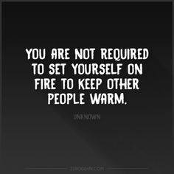

Slide 70
AND ….DON’T TRY TO BURN ANYONE ELSE!!

Slide 75
Let us strive to be agreeable friends…

Slide 76
Not every animal or human appreciates how hard you work

Slide 77
COMPASSION FATIGUE

