Slide 1
Let us strive to be agreeable friends…

Slide 2
Actually don’t assume. Clarify!

Slide 4
Stop saying sorry all the time!!

Slide 5
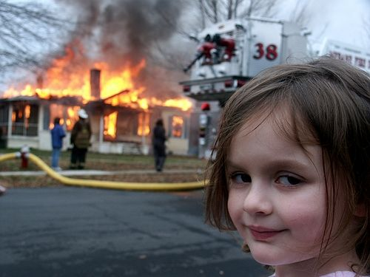
Unless you need to…

Slide 6
If you need to apologize, do it well

Slide 8
How to Apologize (if your behavior actually warrants it)
Own the behavior
No Excuses
Acknowledge how it negatively impacted the other person
Let them know your plan to do better
Do Better
Forgive yourself
Get on with things

Slide 9
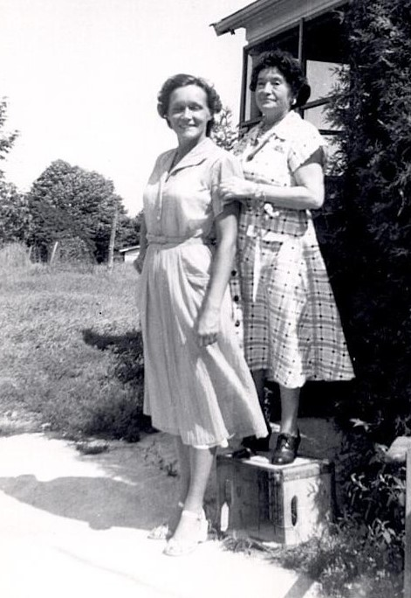
It’s a conversation, not a competition

Slide 10
 | I stand up for my own needs and feelings | I don’t stand up for my own needs and feelings
I care about your needs and feelings | Assertive I Win- You Win | PASSIVE You win – I Lose
I don’t really care about your needs and feelings | AGGRESSIVE I Win- You Lose | PASSIVE AGGRESSIVE You lose - I lose

Slide 12
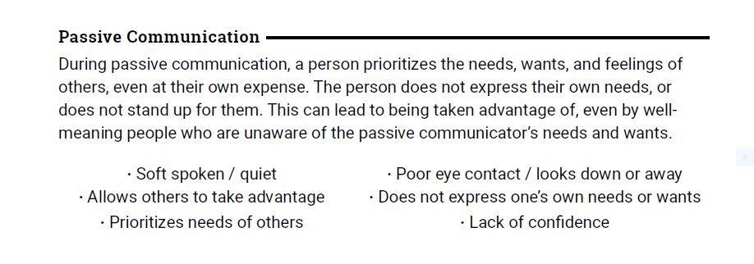

Slide 14
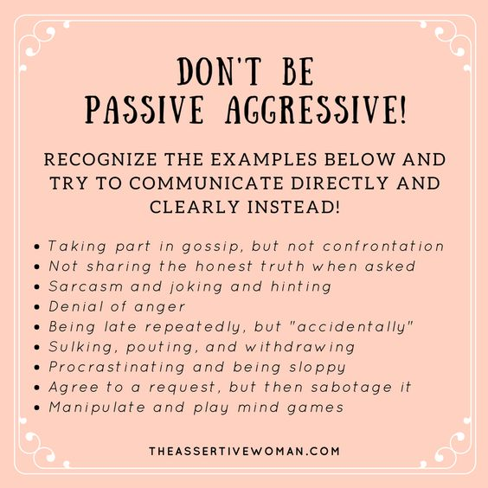

Slide 15
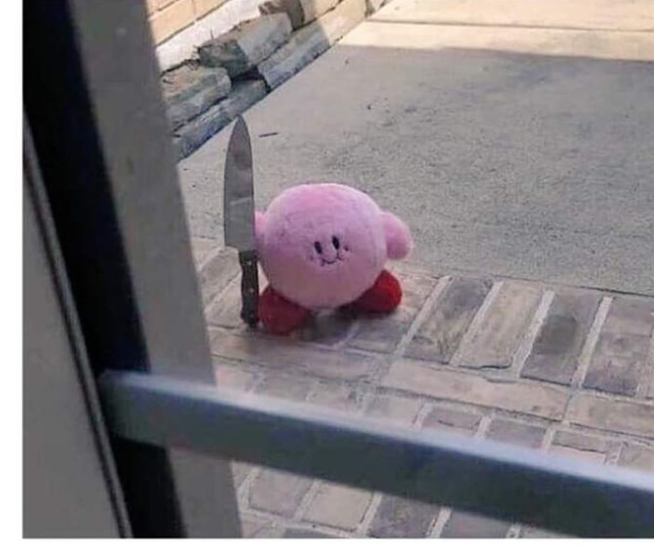

Slide 17
Try not Collude with Passive Aggressive Communication
Options to make it less fun for the other person and prevent yourself from committing a heinous crime
Ask a clarifying question
Express confusion
Use an I statement
Use a good listening strategy
Express your experience of it

Slide 20
 | I stand up for my own needs and feelings | I don’t stand up for my own needs and feelings
I care about your needs and feelings | Assertive I Win- You Win | PASSIVE You win – I Lose
I don’t really care about your needs and feelings | AGGRESSIVE I Win- You Lose | PASSIVE AGGRESSIVE You lose - I lose

Slide 21
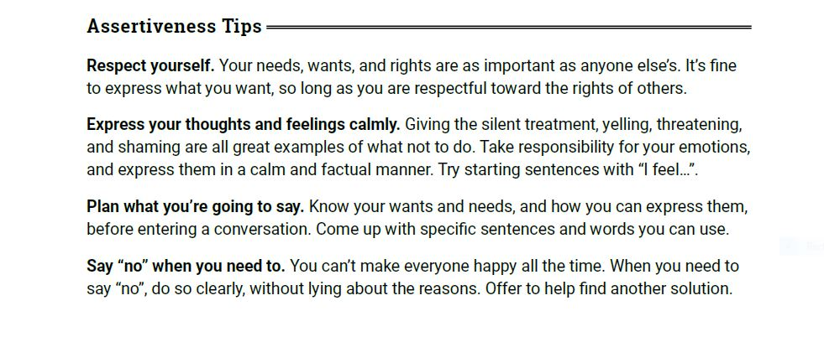

Slide 22
I statements
When you __Describe the specific situation_____
I feel _________emotion word ________
Because ____words to help the other person see how it impacts you ___
and from now on, I wish you would _tell them what would be better going forward

Slide 23
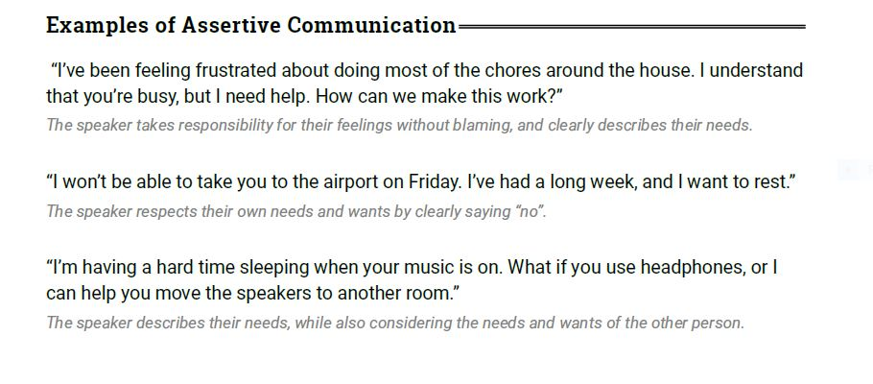

Slide 24
Try using “AND”
instead of
“BUT”

Slide 25
Group Exercise

Slide 27
Communicate Clearly. Ask for what you want and need, don’t assume your friends can read minds.

Slide 28
Try Listening!

Slide 29
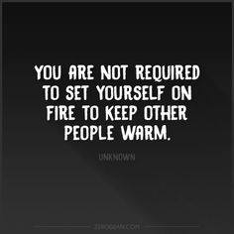

Slide 31
Minimizing Conflict with Wildlife (Rehabbers)
You already know this stuff

Slide 32
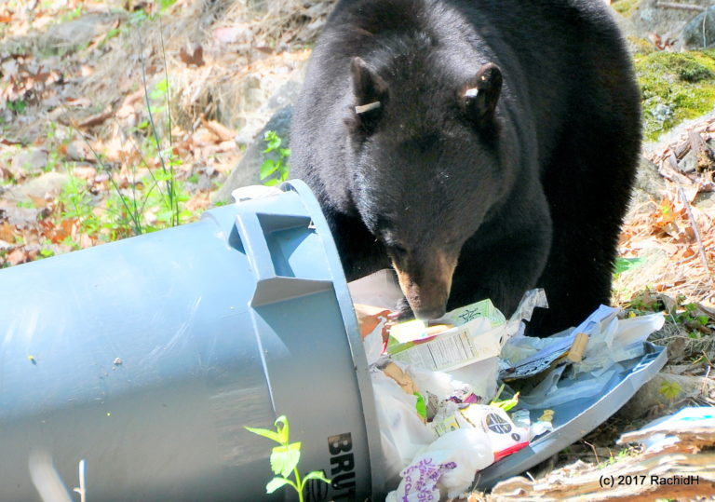
Tip : Don't leave garbage out, put out just before collection
Keep dumpster lids closed.
Don’t Refer to past mistakes and incidences. No garbage-dumping!

Slide 33
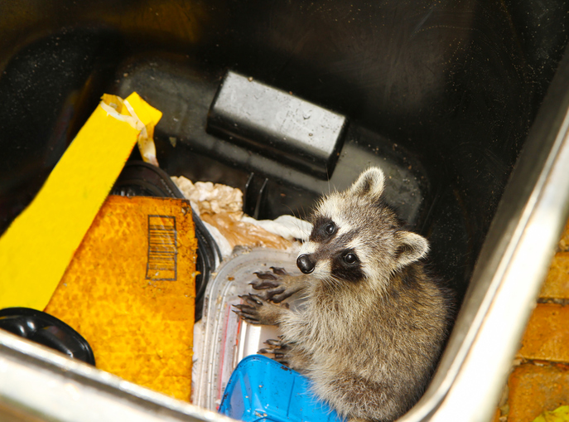
Tip : If a raccoon is stuck in dumpster, prop up a thick branch on an angle so they can climb out. Give them a way out without making them feel trapped.
When someone is stuck, don’t blame. Use “I” statements rather than “you” statements which automatically blame, making the other person defensive.

Slide 34
Tip: Inspect to make sure you don't have any holes/ openings in your house! Make sure your roof is in good repair and attic vents are covered. Put covers on your window wells.
Have good boundaries. Know your limits and respect them. Don’t take things too personally.

Slide 35
Tip: Don't kidnap baby wildlife -- make sure they truly need your help
Find out if they really need help. Before offering advice or help, ask if they need or want it. Sometimes people just need someone to listen, not to fix it for them.

Slide 36
Tip : Move slowly and speak softly to avoid being sprayed by skunks.
Speak to people gently and with respect and things will almost certainly go better. No yelling, swearing, insults, sarcasm, snark, rude gestures or nasty comments about their ancestors.

Slide 37
Tip: Each wild animal is different. Don’t expect a swan to act like a bunny. Each one has unique needs
Don’t make comparisons to other people, stereotypes, or situations. Each person is different and has different needs.

Slide 38
Tip: If possible, put a fallen bird or nest back where it goes, secure it well. Give the parents a chance to do their jobs.
Don’t try to take over for someone else. It may be that they only need a little help to get back on track. Ask them what they need.

Slide 40
BONUS ROUND

Slide 41
Don’t Refer to past mistakes and incidences. No garbage-dumping! 🙂
2. Don’t Blame. Use “I” statements rather than “you” statements which automatically blame, making the other person defensive.
3. Don’t make comparisons to other people, stereotypes, or situations.
4. Don’t play games. A game is being played when you are not being straight about your feelings, and when you are not being direct and honest about what you want or need in a situation. Examples of games are; poor me; silent treatment; martyr; don’t touch me; uproar; kick me; if it weren’t for you…; yes, but…; see what you made me do; and if you loved me…
5. Don’t involve other people’s opinions of the situation (e.g.: “John’s mother agrees with me.”) The only opinions which are relevant are those of the two attempting to communicate at the time.

Slide 42
6. Don’t make threats (e.g., “Do this or else!”). Threats back people into a corner and they may choose the ultimatum in order to save face. You may find later you really do not want to carry out your threat.
7. Don’t demand to win. If you do, your discussion will surely become an argument.
8. Don’t say “always” and “never”. (“You always…” “You never…”) These are usually exaggerations and will put the other person on the defensive.
9. Don’t interrupt, talk over or make comments while the other person is speaking. Watch your non-verbal expressions too. Rolling eyes, smirking, yawning etc. all work against fair fighting.
10. Don’t walk away or leave the house without saying to your partner, “I’ll be back”.
11. No finger pointing.

Slide 43
12. Don’t save up feelings and dump them all at once, try to air feelings often.
13. Try not to yell.
14. No talk of Ending friendship or quitting rehab life. (Not in the moment) In the heat of an argument, threatening to leave the relationship is manipulative and hurtful. It creates anxiety about being abandoned and undermines your ability to resolve your issues. It quickly erodes your partner’s confidence in your commitment to the relationship. Trust is not easily restored once it is broken in this way. It makes the problems in your relationship seem much bigger than they need to be.
15. Don’t read your partner’s mind.
16. Don’t expect your partner to read your mind.

Slide 44
15. Don’t use the following: swearing, denunciation, obscenities, character assassination, contempt, sarcasm, or taunting.
16. Do not assume, guess, imagine, take for granted, theorize, surmise, speculate, make gestures, judgments, funny glances or faces about what your partner means. Find out!
17. No belittling each other’s accomplishments. No matter how small or odd they may be.
18. Don’t be afraid to apologize when you are wrong. It shows you are trying.
19. Don’t argue about details. Avoid exchanges like, “You were 20 minutes late,” “No, I was only 13 minutes late.” (An easy way to distract from the problem.)

Slide 45
1. Deal with the Here and Now. What is the specific problem right now? Anything older than 24 hours is garbage, so no garbage-dumping!
2. Take responsibility. Use “I” statements as a way to show you are taking responsibility for your own feelings and actions.
3. Be direct and honest about your feelings and what you want.
4. Listen and hear! Try to deal with the other person’s perceptions of the situation as well as your own. Be aware of his/her feelings as well as your own. Check to see whether what you heard is really what the other person is trying to express, and ask him to let you know what she hears you saying.
5. Give the other person equal time. Both people need to express their feelings and points of view to create a full mutual understanding.
6. Attack the issue, not the person. Name-calling puts people in a position to respond angrily and defensively. This is usually used when a person feels he is losing. Name-calling breaks down communication and destroys trust in the relationship.
7. Take a breather by paraphrasing what you think you heard them saying. “I understand you want to tell me about your day but I need a few minutes to finish what I am doing.” This gives you time to think about your response.

Slide 46
8. Focus on solving a problem/reaching a solution rather than venting your anger or winning a victory. Think win-win.
9. Deal with one issue at a time. No fair piling several complaints into one session. Some people call this “kitchen-sinking” – talking about everything including the kitchen sink!
10. Limit your discussion/fight to no more than 30 minutes. Adults have relatively short attention spans – just look at television programming to confirm this. Long drawn out discussions/fights rarely reach resolution. Instead they just wear the participants out. And when you are worn out, the potential of saying or doing something you’ll regret is much greater. If you are unable to solve your problem in the 30 minutes that you’ve allotted, schedule another time to continue.
11. Brainstorm solutions. Be willing to compromise. Give a little to get a little.
12. Go forth as equals. Don’t use power plays. Gauge the intensity of your anger to the ego strengths of the other person and be responsible with the things your mate has entrusted to you in your relationship. YOU ARE ON THE SAME TEAM.

Slide 47
13. When necessary, take a time-out. A time-out is a short break to cool off, calm down and get perspective. Think of it like pushing the pause button on a video. It’s an opportunity to restore calm and be more reflective instead of reactive. Use the time-out to reflect on why you feel the way you do and how to express yourself in a positive way. Try to think about the other person’s feelings and point of view. Think things through before you speak. Then “push play” again and return to each other to resolve the issues calmly. A time-out should be at least a half-hour long (but no longer than twenty-four hours). It takes at least a half-hour for your body’s physiology to return to a normal resting state and for your thoughts to become less hostile or defensive. It’s surprising how different a person’s outlook can be after they’ve had a chance to calm down.
14. Give each other the ability to withdraw or change their mind.
15. Speak softly. If you and your partner have a natural tendency to raise your voice, try whispering.
16. Identify and Define your issue or topic, and stick to it! Don’t change the subject or bring in unrelated items. If you have a different item you’d like discuss, save it for the next discussion.
17. Hold hands. METAPHORICALLY (We are not fighting each other, but talking over a problem we are mutually trying to resolve. )
18. Ask questions that will clarify, not judge. A question should never begin with the word “why.” That puts people on the defensive — and we know that defensiveness stops conversation rather than continues it.

